Slide 1
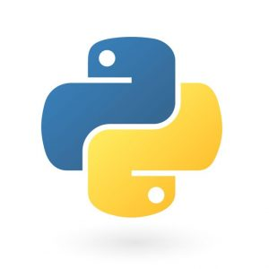
Python Foundation Course

Slide 2
About me
- Anil Mandapati
10+ experience in IT
I am data engineer
Design Data models
Worked on different databases
Love to play with data.
Passionate on R&D’s.

Slide 3
Pre-requisites
Python 3.x ( Preferable 3.6)
Any IDE
Jupyter Notebook (Optional)
Spyder (Optional)
Pycharm (Optional)
Software to install from SOND:
Pycharm community version
Python Anaconda

Slide 4
Course Overview

Slide 5
Introduction
Programming Paradigms
Why Python?
Tips to become good programmer
Walkthrough on IDE’s
Python Version Differences

Slide 6
Objects and
Data Structure Basics
Numbers
Strings
Lists
Tuples
Dictionaries
Sets
Booleans

Slide 7
Comparison
Operations
Basic Operators
Chained Comparison Operators

Slide 8
Python Statements
Conditional Operators
Loops
Range
List Comprehension

Slide 9
Methods and Functions
Methods
Functions
Lambda Expressions
Nested Statements
Scope

Slide 10
Built-in Functions
Map
Reduce
Filter
Zip
enumerate
All and any
random

Slide 11
Let’s play with Python
Milestone Project

Slide 12
Object Oriented Programming
Objects
Classes
Methods
Inheritance
Special Methods

Slide 13
File Handling
Read
Write
Append

Slide 14
Errors and exception Handling
Errors
Exception
try
except
finally

Slide 15
Let’s play with Python
Milestone Project - II

Slide 16
Modules and packages
. Creating Modules
. Installing modules

Slide 17
Decorators In python

Slide 18
Python Generators
Iterators vs Generators
Creating Generators

Slide 19
Real-time Demo’s
Demo – I
Demo - II

Slide 20
Advance Python modules
Collections
Regular Expression
Date time
Time it
Python Debugger

Slide 21
Stay Tuned….

Slide 22
Programming Paradigms
- It is an approach to solve problem using some programming lang.
Imperative PL ( How we do )
Declarative PL ( What we do )
Logical Programming
Procedural programming
Object Oriented Programming
Functional programming
Parallel processing
Database processing

Slide 23
Why Python?
Simple
Elegant Syntax
Large standard library
Interactive mode
Open Source

Slide 24
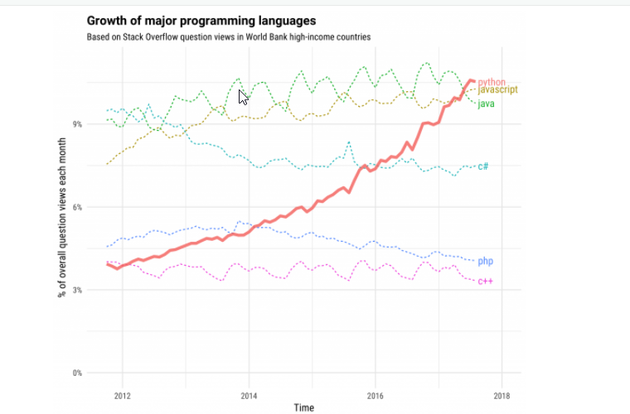
Why Python?

Slide 25
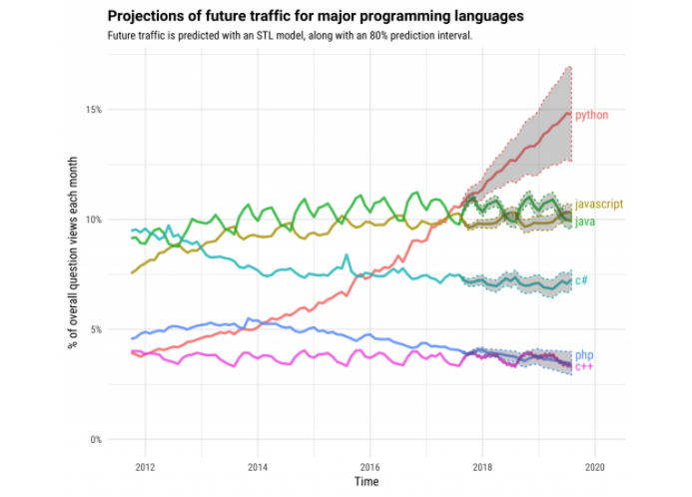
Why Python?

Slide 26
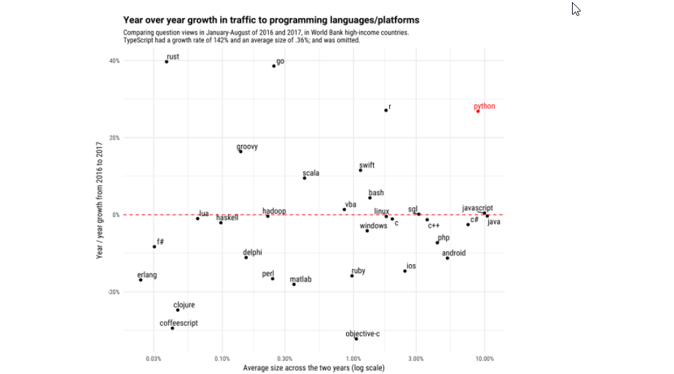
Why Python?

Slide 27
How to become good programmer?
More time on analysis
Divide and conquer
Write Pseudo code
Implement same requirement in different styles
Help others ( Forums)

Slide 28
Numbers
Python has various "types" of numbers (numeric literals). We'll mainly focus on integers and floating point numbers.
Integers are just whole numbers, positive or negative. For example: 2 and -2 are examples of integers.
Floating point numbers in Python are notable because they have a decimal point in them, or use an exponential (e) to define the number. For example 2.0 and -2.1 are examples of floating point numbers. 4E2 (4 times 10 to the power of 2) is also an example of a floating point number in Python.
Examples | Number "Type"
1,2,-5,1000 | Integers
1.2,-0.5,2e2,3E2 | Floating-point numbers

Slide 29
Variables
The names you use when creating these labels need to follow a few rules:
Names can not start with a number.
There can be no spaces in the name, use _ instead.
Can't use any of these symbols :'",<>/?|\()!@#$%^&*~-+
It's considered best practice (PEP8) that names are lowercase.
Avoid using words that have special meaning in Python like "list" and "str"

Slide 30
Strings
Strings are used in Python to record text information, such as names. Strings in Python are actually a sequence, which basically means Python keeps track of every element in the string as a sequence.
In this lecture we'll learn about the following:
1.) Creating Strings
2.) Printing Strings
3.) String Indexing and Slicing
4.) String Properties
5.) String Methods
6.) Print Formatting

